Slide 1

Data Analysis Essentials
Cornerstone Project
Road Accident Data Analysis(India)
Presented by
N.V . Nanda Kishore(25B11CS644)
P . Lakshmanudu (25B11CS774)
B . Harshini(25B11CSA80)
D . Sai Vyshnavi(25B11CS246)
Y . Ram Prasad(25B11CSA47)
Guide: Mr. K. Ashok Teja, Assistant Professor, CSE Dept.
Department of Computer Science and Engineering

Slide 2




Contents
• Problem Statement
• Introduction
• Current Approach & Limitations
• Proposed Approach
• Dataset Description
• Code Snippets
• Methodology
• Data Visualization
• Key Insights & Analysis
• Implementation Workflow
• Conclusion

Slide 3
PROBLEM STATEMENT
  Road accidents are a major public safety concern, and accident records can be difficult to understand when stored as raw data. Analyzing accident information across different years and accident categories requires systematic data analysis. This project applies data analysis techniques to study road accident records from 2021 to 2024, identify important patterns, and present the findings through clear visualizations.

Slide 4
Introduction
• Road accidents are a major public safety concern in India.
• Accident records contain useful information about accident conditions and outcomes.
• Accident patterns can vary across different years and categories.
• Python helps clean, organize, and analyze accident data.
• Pandas, NumPy, Matplotlib, and Seaborn are used for analysis and visualization.
• This project analyzes road accident records from 2021 to 2024 to identify patterns and trends.

Slide 5
Current / Manual Approach
• Accident data is stored in raw CSV or tabular records.
• Records are reviewed and compared manually.
• Identifying year-wise patterns requires manual effort.
• Comparing accident categories is difficult from raw data.
• Accident relationships are not easily visible.
• Raw tables provide limited visual understanding.

Slide 6
Limitations of Manual Analysis
• Manual analysis is time-consuming.
• Large datasets are difficult to process manually.
• Comparing accident patterns is difficult.
• Relationships between accident factors are not easily identified.
• Visualizing patterns manually is difficult.
• Manual processing can lead to errors.

Slide 7
Proposed Approach
• Dataset loading and initial exploration
• Data filtering and extraction of relevant accident records
• Data validation and cleaning
• Data aggregation and representation
• Descriptive and statistical analysis
• Category-wise and trend analysis
• Data visualization using charts and heatmaps
• Interpretation of results and identification of key accident patterns

Slide 8
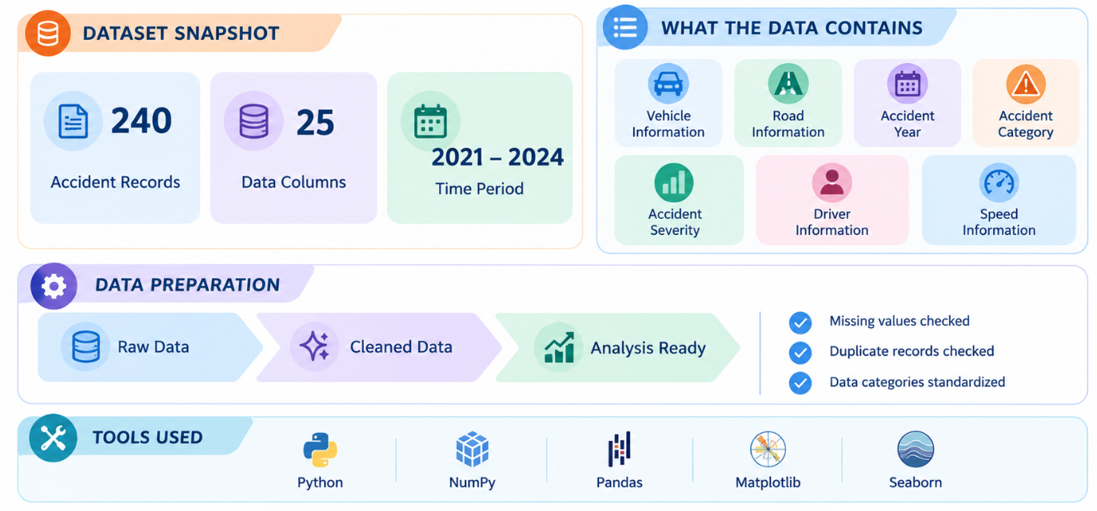
DATASET DESCRIPTION
Road accident dataset used for analysis — covering recorded accident data from 2021 to 2024.

Slide 9
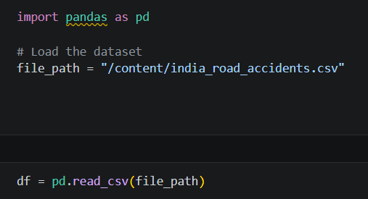
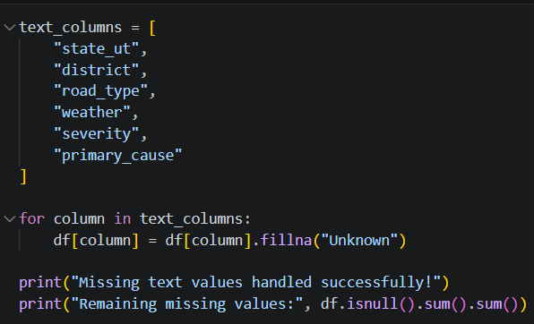
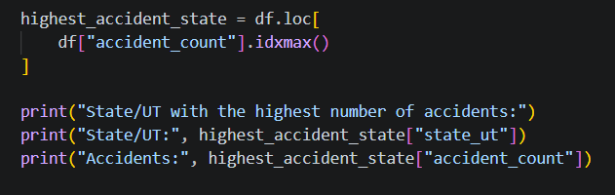
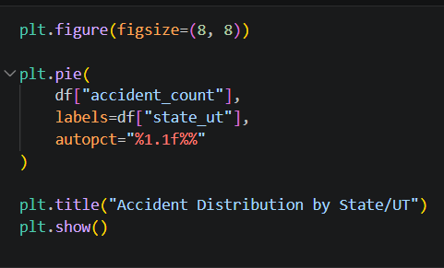
CODE SNIPPETS
Data Loading
Data Cleaning
Data Analysis
Data Visualization

Slide 10
METHODOLOGY
Module 1 – Data Loading & Reading
Load the road accident dataset using Python and Pandas.
Module 2 – Data Acquisition & Filtering
Select relevant accident records and filter the required data.
Module 3 – Data Extraction
Extract important fields required for accident analysis.
Module 4 – Data Validation & Cleaning
Check data quality, missing values, duplicates, and consistency.

Slide 11
METHODOLOGY
METHODOLOGY
Module 5 –Data Aggregation & Representation
Group and summarize accident data for meaningful comparison.
Module 6 – Data Analysis
Analyze accident patterns, trends, and relationships between variables.
Module 7 – Data Visualization
Create bar charts, pie charts, trend charts, and correlation heatmaps.
Module 8 – Results & Interpretation
Interpret the visualized results and identify important accident patterns and findings.

Slide 12
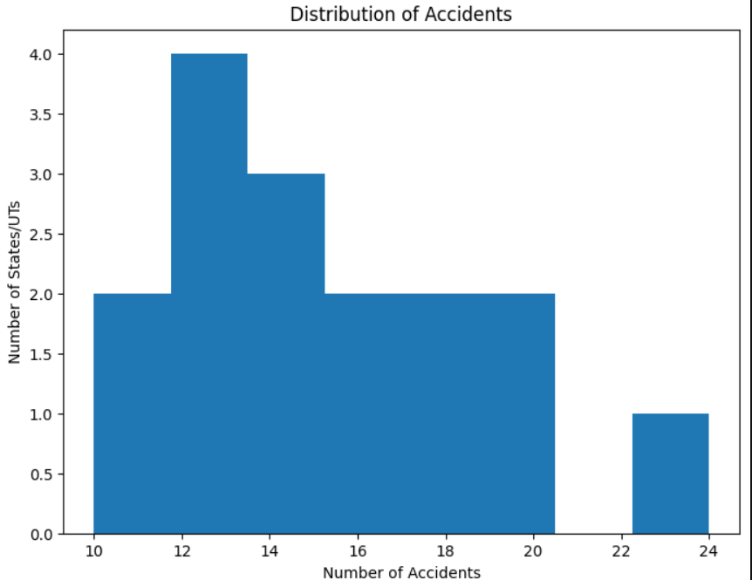
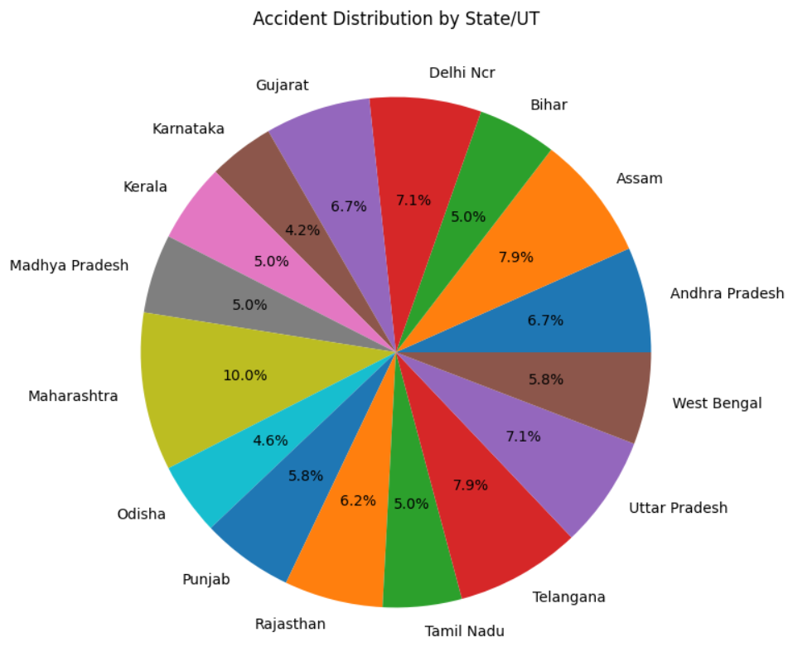
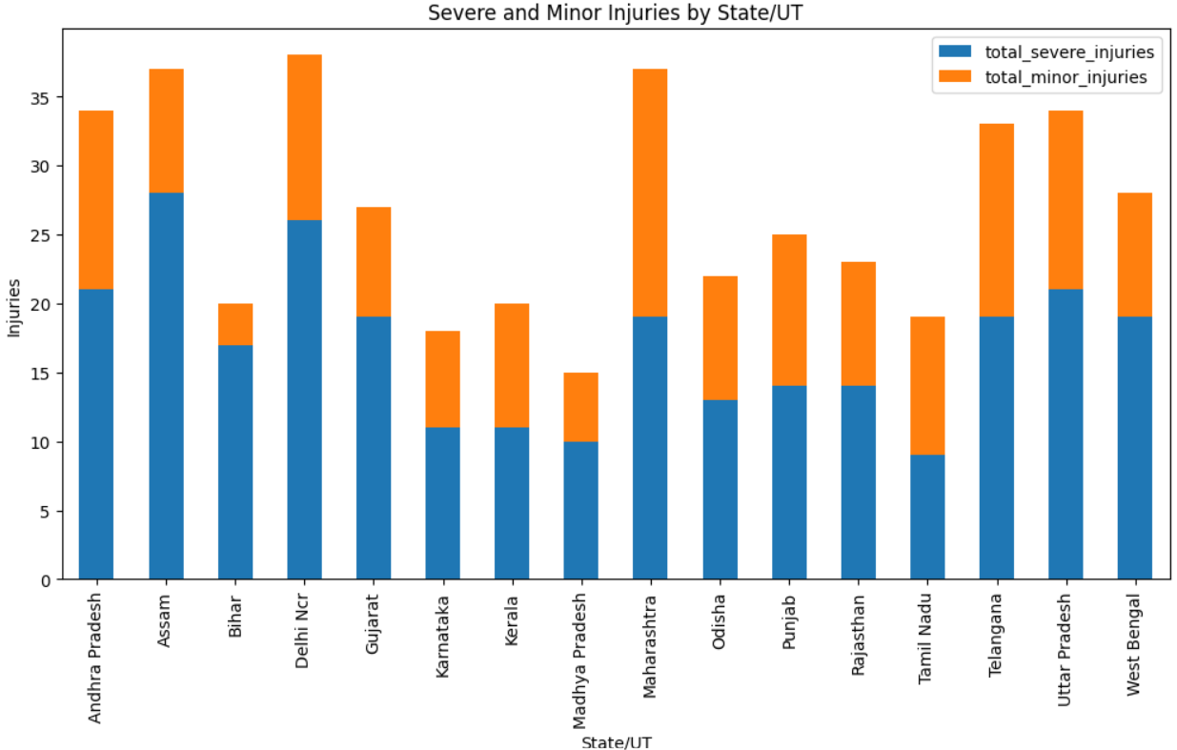
Data Visualization

Slide 13
Key Insights & Analysis
• 2024 recorded the highest number of accidents with 72 cases.
• Fatal accidents were the most common severity category, with 118 cases.
• Overspeeding was the leading recorded cause, appearing in 74 accidents.
• Two-wheelers were the most common vehicle type, involved in 81 accidents.
• 81.7% of the recorded accidents exceeded the road speed limit.
• 21.7% of accidents involved alcohol, while 29.6% involved pedestrians.
• Daylight accidents were more common, with 135 recorded cases.

Slide 14
Implementation Workflow
1. Data
Loading & Reading
2. Data
Acquisition & Filtering
3. Data Extraction
4. Data Validation & Cleaning
5. Data Aggregation & Representation
6. Data Analysis
7. Data Visualization
8. Results & Interpretation
Output: Cleaned Dataset → Analysis → Visualizations → Key Insights

Slide 15
CONCLUSION
• This project demonstrates a complete data analysis workflow for road accident data using Python.
• Data cleaning and preprocessing improve the reliability of the analysis.
• Visualizations make accident patterns and trends easier to understand.
• The analysis helps identify important factors and patterns related to road accidents.
• The findings can support better understanding of accident patterns and road safety analysis.
Future scope:Larger datasets, recent/live data, and predictive analysis can be used for further study.

Slide 16
THANK YOU

